Slide 1
Compact and Light-Weight Automated Semen Analysis Platform Using Lensfree on-Chip Microscopy
Author: Ting-Wei Su,† Anthony Erlinger,† Derek Tseng,† and Aydogan Ozcan*,†,‡
Electrical Engineering Department, University of California, Los Angeles, California, and California NanoSystems
Institute, University of California, Los Angeles, California
Presenter: DUCK-HA HWANG
Notes:
Hi everyone. My name is DUCK-HA, HWANG.
I will present Compact and Light-Weight Automated Semen Analysis Platform Using Lensfree on-Chip Microscopy.

Slide 2

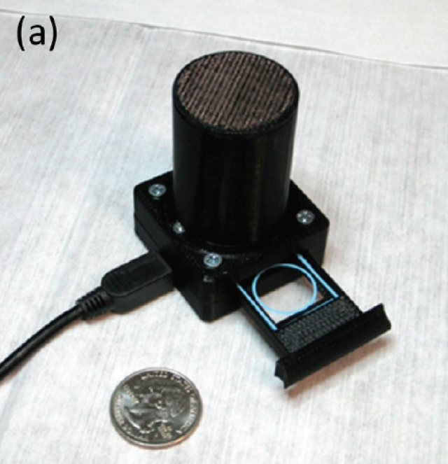
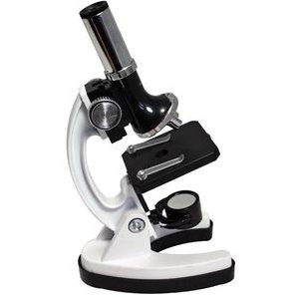
Notes:
-This holographic on-chip imaging platform weighs ∼46 g, measures ∼4.2 × 4.2 × 5.8 cm, and does not require any lenses, lasers or other bulky optical components to achieve phase and amplitude imaging of sperms over ∼24 mm2 field-of-view with an effective numerical aperture of ∼0.2.
-conventional (compond microscopy): 32 lbs (14kg)//
-Lens free microscopy is cost-effective, because they do not require lenses, lasers or mechanical stages. Moreover, it is light-weight. It can be easily miniaturized because of compactness. In addition, lens free microscopy based on holography which can provide wide filed of view, if unit magnification is implemented. This can be achieved by decreasing the distance between sample plane and measurement plane. (price, weight, compactness, imaging field of view)

Slide 3


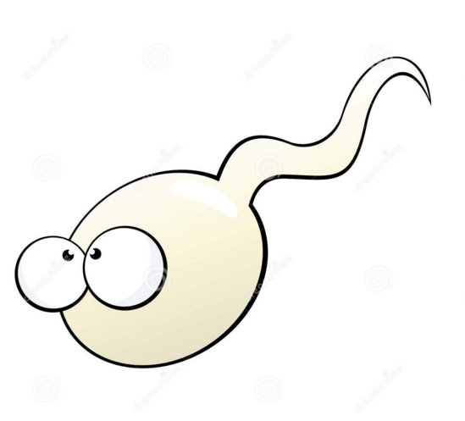


Slide 4

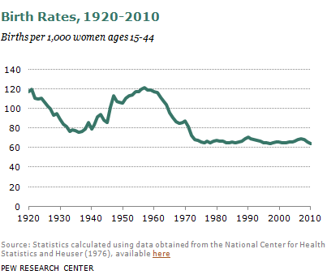

Slide 5


Notes:
Breeding animals

Slide 6
Analysis Sperm’s fertility
HOW?
Digital subtraction of these consecutive lensfree frames, followed by appropriate processing of the reconstructed images
Density
- Count sperm on the image. (High density, High fertility)
Motility
- Count moving sperms, Count stationary sperms. (High motility, High fertility)
Speed
- Calculate speed using the dynamic trajectories of motile sperms(High speed, High fertility)

Slide 7
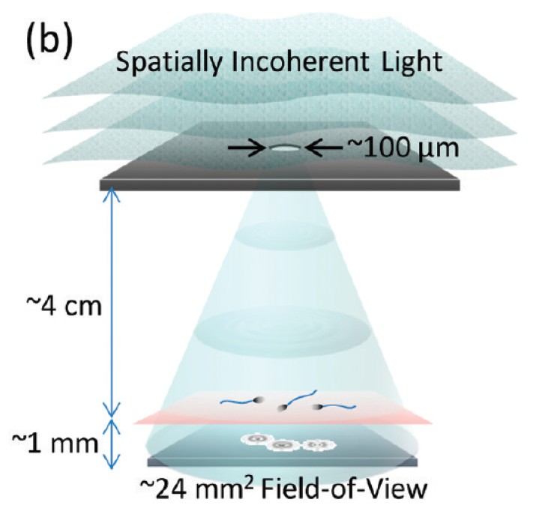
LED Fiber
Pinhole
Sample
sensor chip

Slide 8
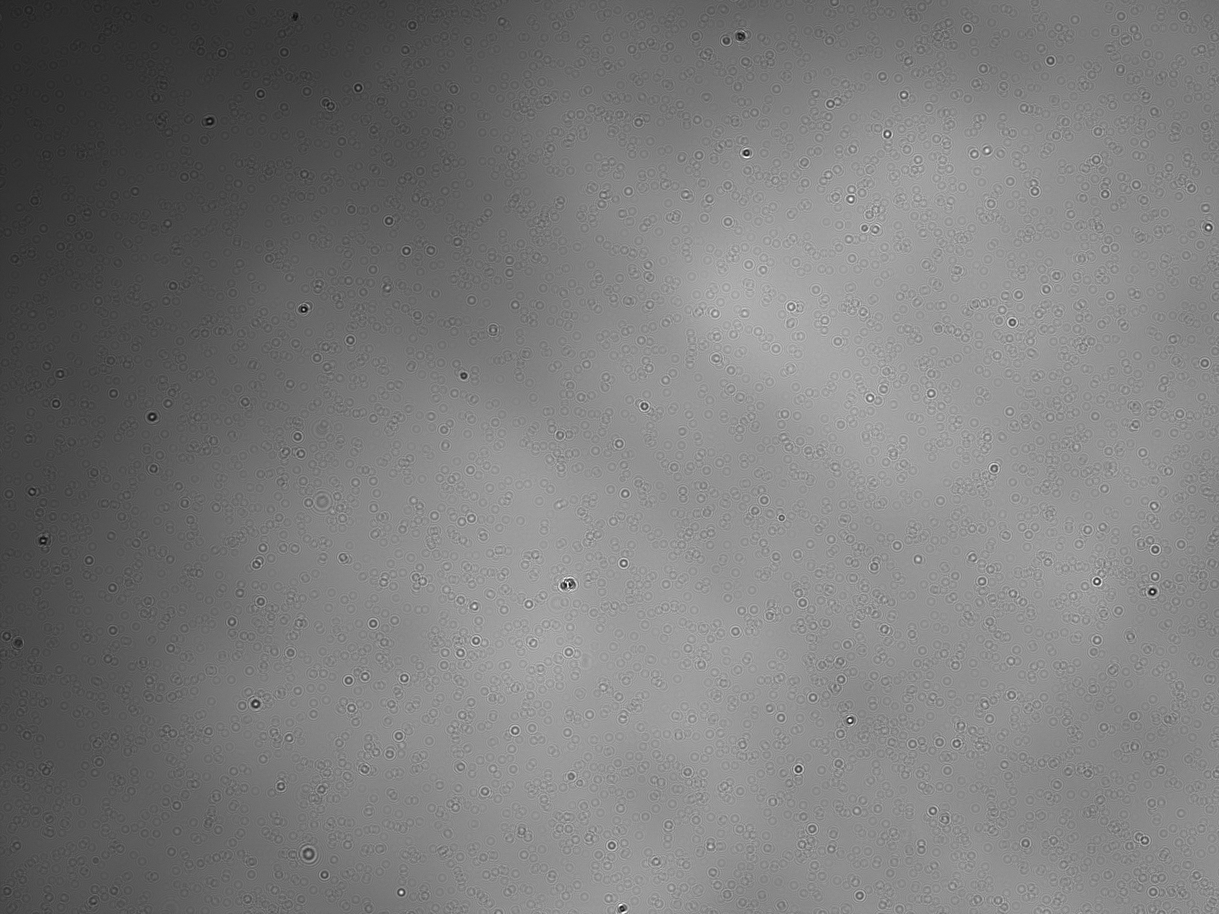
Recorded Hologram
Zoom In

Slide 9
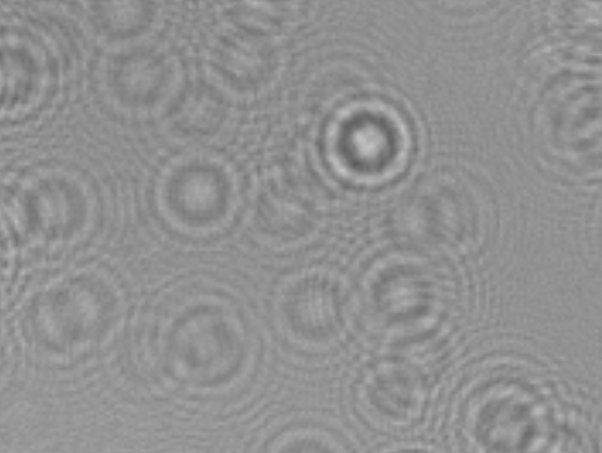
Zoom in Image

Slide 10
Reconstruct Image (Computational Process)
Phase
Amplitude

Slide 11
Hologram Image

Slide 12
Sperms’ Head
Reconstructed
Phase Image

Slide 13
Sperms’ Head
Reconstructed
Amplitude Image

Slide 14
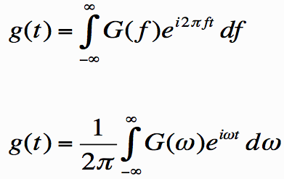
Fourier Transform
Notes:
Cell VU 600
Depth 20 um.

Slide 15
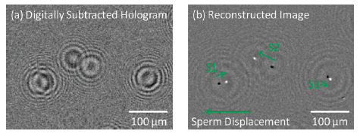
Sperms’ 2D Trajectory
Notes:
(a) A digitally subtracted lensfree hologram of three moving sperms is generated from two successive frames (500 ms apart) (b) A
microscopic image, that is digitally reconstructed from the lensfree differential hologram shown in (a), illustrates the positions of three sperms
in two successive frames (white spots show the sperms’ end positions and black spots show their starting positions). The displacement vectors
of these sperms are labeled as S1, S2, and S3.

Slide 16
3D-> 2D trajectory
WHY?
Chamber
Cell VU 600
Depth 20 um
Size of Human Sperm’s Head
head 5.1 µm by 3.1 µm and a tail 50 µm long
Notes:
Cell VU 600
Depth 20 um.

Slide 17
HOW?
Subtract Background
(ex: First Hologram Image – Second Hologram Image)
Reconstruct Image
Find moving objects
Compare each pixel
Record trajectory

Slide 18
1
2
1
2
2
1

Slide 19
Analysis Sperms
Count (number of sperm): 233
Median (speed): 16.4004 um/sec
Mean (speed): 21.9802 um/sec
Notes:
3720 n second, 3.27 second // (0.4 frame/sec // 9 frame)

Slide 20
Motility
Stationary sperms
Average hologram image
(Combine each frame and divided by number)
Moving sperms
leave stationary ones
Count stationary sperms

Slide 21
Stationary sperms

Slide 22
Zoom in

Slide 23
Compare with moving trajectory

Slide 24
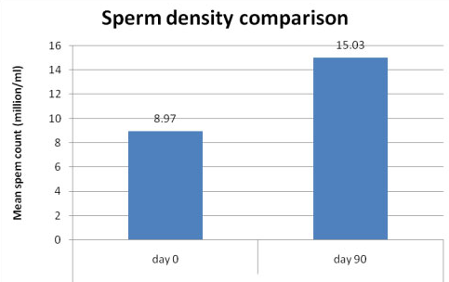
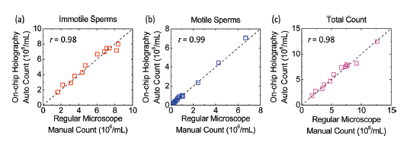
Analysis Fertility of sperms
Count (number of sperm): 233
Median (speed): 16.4004 um/sec
Mean (speed): 21.9802 um/sec
Density
Speed
Sample1
Sample2
Motility

Slide 25
Commercialization
WHAT?
More widespread Lens-free Microscopes
-Cost effective
-Easy user interface
-Fast analysis
-Simple product
-Design

Slide 26
Direction of improvement
Reconstruct sperms’ tail
Network System

Slide 27
HOW?
Two light source
LED Fiber
One light source
Sample
Sample
sensor chip
sensor chip

Slide 28
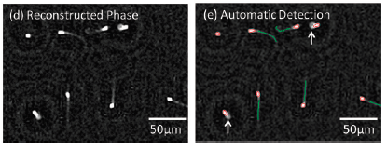
WHY?

Slide 29

Laboratory Experiment
Network system

Slide 30
Conclusion

Slide 31
END

Slide 32


